Slide 1
Sentiment Analysis on Corona Virus Tweets
Presented by
Fhamid Mottaki Aurnob 170204058 Mohammad Najrul Islam 170204061 Rafsan Habib Rasan 170204069

Slide 2
Overview
Introduction
Motivation
Literature Review
Dataset Description
Implementation
Result Analysis
Future Work
Conclusion
References

Slide 3
Introduction
The World Health Organization (WHO) classified COVID-19, also known as Corona Virus
Disease of 2019, as a pandemic on March 11, 2020.[1]
People are experiencing worry, dread, and anxiety as a result of the exponentially increasing number of instances throughout the world.
The worldwide population’s mental and physical health has been proven to be directly proportionate to this pandemic sickness.

Slide 4
Motivation
Analyzing the social media posts; in our case from twitter we can predict the severity of the virus among the user of this platform using their information.
Therefore, This study will be an analysis of the sentiments expressed through the tweets regarding COVID-19 since the beginning of the pandemic.

Slide 5
Literature Review
Paper Title | Dataset | Used Method | Results
A sentiment analysis approach to predict an individual’s aware- ness of the precautionary procedures to prevent COVID-19 out-breaks in Saudi Arabia[2] | 2,42,525 tweets from five regions in Saudi Arabia | support vector machine (SVM), k-nearest neighbor (KNN) and Naïve Bayes (NB) | SVM produced highest Accuracy
Predicting Coronavirus Pandemic in Real-Time Using Machine Learning and Big Data Streaming System[3] | gathered tweets by employing N-Gram model and TF–IDF as well as explored sentiments | DT, LR, KNN, RF and SVM | RF model using the unigram method has achieved the best performance

Slide 6
Dataset Description
The dataset is a collection of postings form Twitter.
The dataset was taken from Kaggle.
The tweets have been pulled from Twitter and manual tagging has been done then.
The dataset has a total of 44955 rows and 6 columns .
Link to the dataset: https://www.kaggle.com/datatattle/covid-19-nlp-text-classification

Slide 7
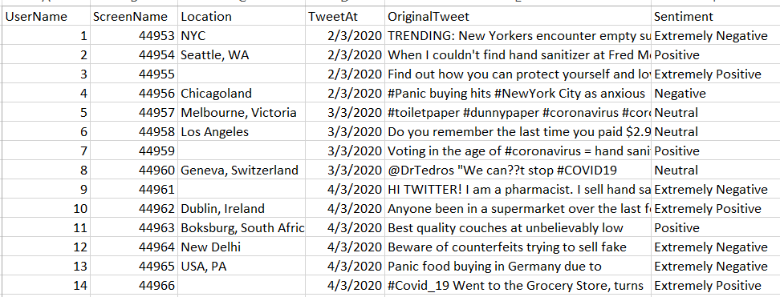
Dataset (Continued)
Sample of Dataset:
Figure: Dataset Sample

Slide 8
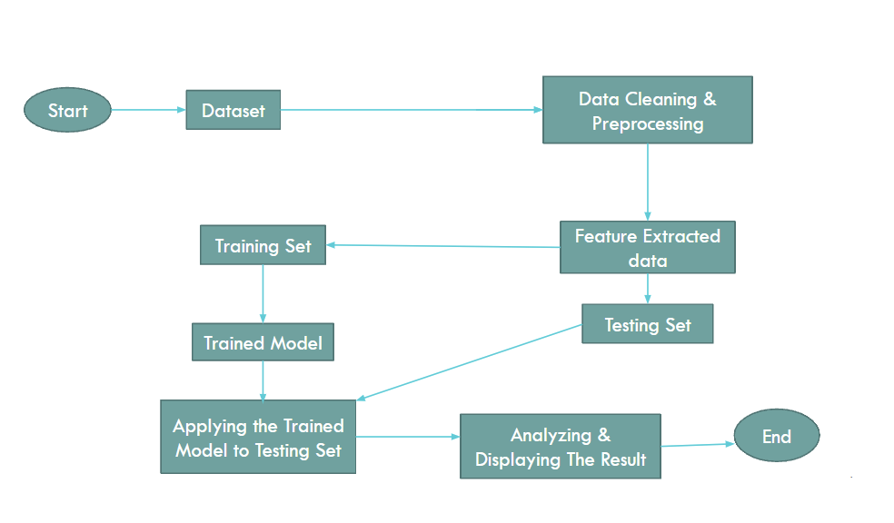
Implementation

Slide 9
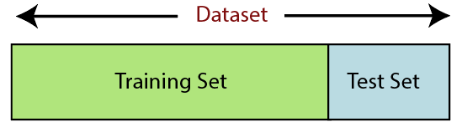
Implementation (Continued)
Dataset Splitting:
The dataset was divided into two sets (Train & Test set)
80% data for training set and 20% for testing set

Slide 10
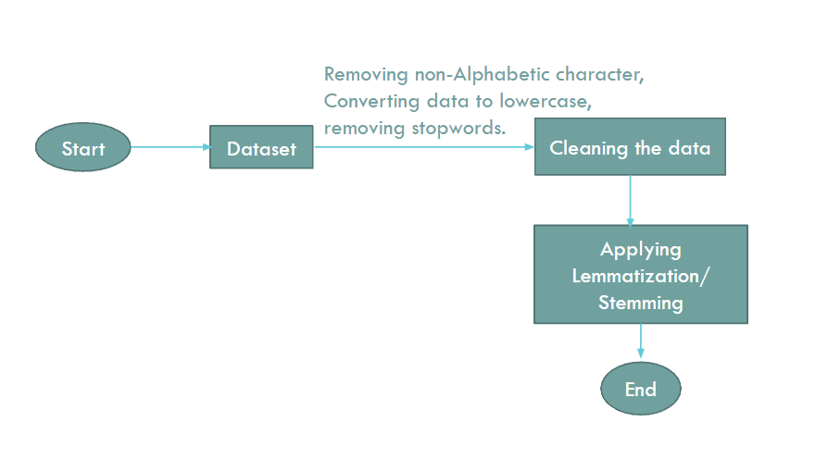
Implementation (Continued)
Data Preprocessing:

Slide 11
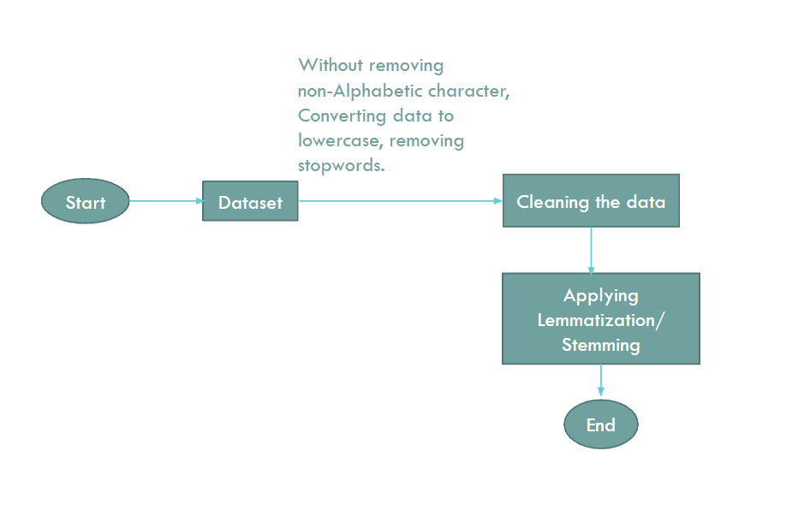
Implementation (Continued)
Data Preprocessing:

Slide 12
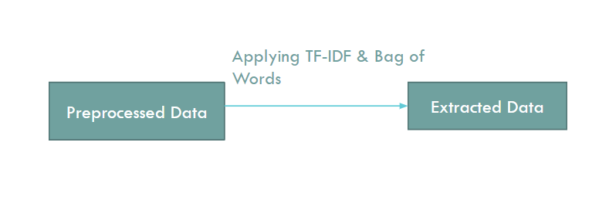
Implementation (Continued)
Feature Extraction:

Slide 13
Implementation (Continued)
Machine Learning Algorithms:
Support Vector Machine(SVM)
Logistic Regression(LR)
Naïve Bayes
Random Forest(RF)
eXtreme Gradient Boosting(XGBoost)

Slide 14
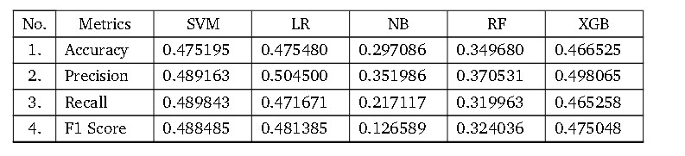
Result Analysis
Model 1 Exp 1: Lemmatization + TF-IDF(without removing non alphabetic characters)
Table 1: Performance Scores for Model1 Exp 1

Slide 15
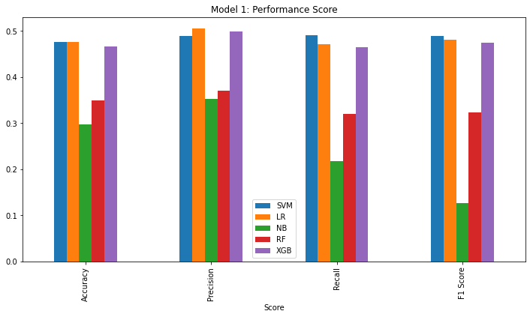
Result Analysis(Continued)
Comparison Graph

Slide 16
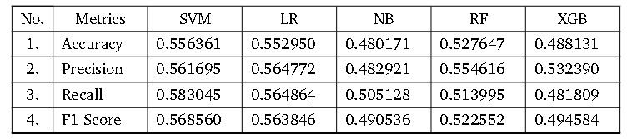
Result Analysis (Continued)
Model 1 Exp 2: Lemmatization + Bag of Words(without removing non alphabetic characters)
Table 1: Performance Scores for Model1 Exp 2

Slide 17
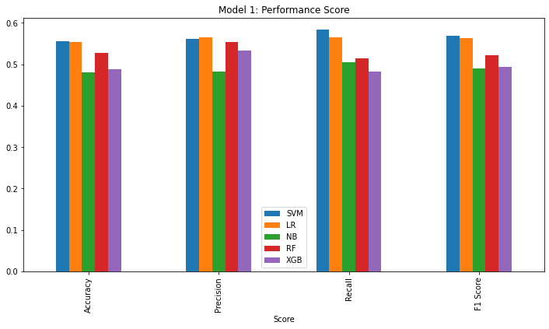
Result Analysis(Continued)
Comparison Graph

Slide 18
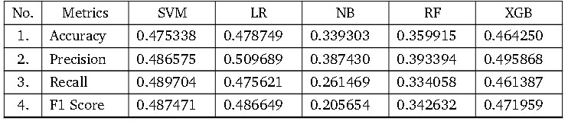
Result Analysis (Continued)
Model 2 Exp 1: Lemmatization + TF-IDF(with removing non alphabetic characters)
Table 1: Performance Scores for Model2 Exp 1

Slide 19
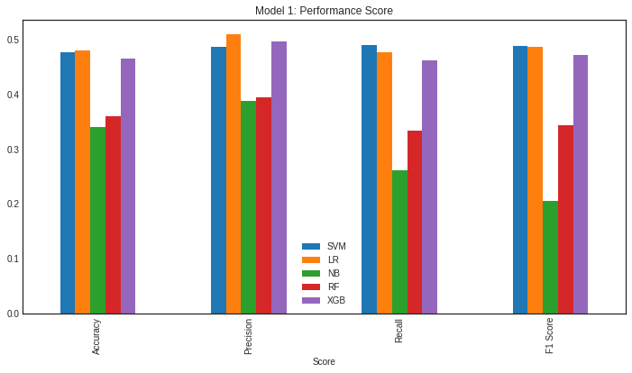
Result Analysis(Continued)
Comparison Graph

Slide 20
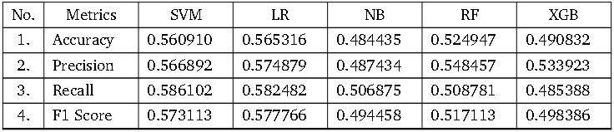
Result Analysis (Continued)
Model 2 Exp 2: Lemmatization + Bag of Words(with removing non alphabetic characters)
Table 1: Performance Scores for Model2 Exp 2

Slide 21
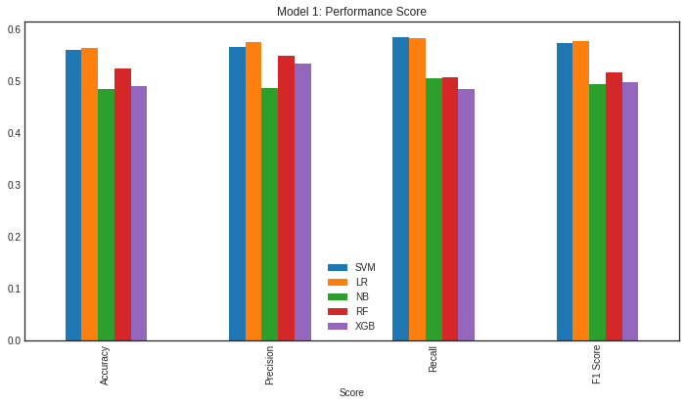
Result Analysis(Continued)
Comparison Graph

Slide 22
Future Work
To improve results and see the differences between various models:
we intent to apply different deep learning algorithms.
We will utilize a different enriched dataset and intend to employ alternative feature extraction methods.

Slide 23
Conclusion
With the help of this project, we can identify people’s views on COVID-19 .
We got the best result for SVM and Logistic Regression which is 56.09% and 56.53%, while using Bag of Words for feature extraction and Lemmatization with removing non alphabetic characters on the test data set.

Slide 24
References
[1] https://www.who.int/director-general/speeches/detail/who-director-general-s-opening-remarks-at-the-media-briefing-on-covid-19---11-march-2020
[2] S. S. Aljameel, D. A. Alabbad, N. A. Alzahrani, S. M. Alqarni, F. A. Alamoudi, L. M.Babili, S. K. Aljaafary, and F. M. Alshamrani, “A sentiment analysis approach to predict an individual’s awareness of the precautionary procedures to prevent covid-19 outbreaks in saudi arabia,” International journal of environmental research and public health, vol. 18,no. 1, p. 218,202
[3] X. Zhang, H. Saleh, E. M. Younis, R. Sahal, and A. A. Ali, “Predicting coronavirus pan- demic in real-time using machine learning and big data streaming system,” Complexity, vol. 2020, 202

Slide 25
THANK YOU!

